Slide 1

ZOMATO SALES ANALYSIS
KAVYA R
23/02/2025

Slide 2

AGENDA
INTRODUCTION
OBJECTIVE
DATASET OVERVIEW
METHODOLOGY
DATA ANALYSIS
SUBJECTIVE ANALYSIS
RECOMMENDATION
CONCLUSION

Slide 3

INTRODUCTION
Zomato is a global platform for restaurant discovery and food delivery.
It offers restaurant listings, customer reviews, and online ordering.
Uses data analytics to enhance customer experience and business decisions.
Sales analysis identifies trends based on location, pricing, and demand.
Evaluates the impact of online delivery, table bookings, and customer preferences.

Slide 4
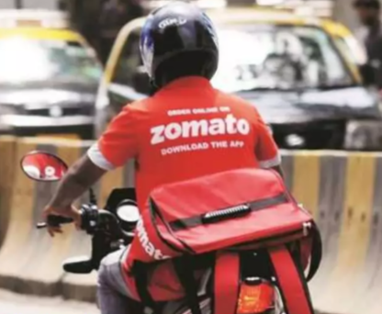
OBJECTIVES
Identify key factors influencing restaurant ratings and customer satisfaction.
Analyze location-based trends to determine potential areas for expansion.
Examine the impact of pricing, cuisine variety, and delivery services on business performance.
Provide data-driven insights to improve restaurant strategies and customer experience.
Support decision-making for restaurant owners and investors with meaningful analytics.

Slide 5

DATASET OVERVIEW
Total Restaurants: 9,052 across multiple countries.
Geographical Coverage: Includes India, USA, UK, UAE, Brazil, and more.
Attributes Tracked: Location, pricing, cuisines, delivery options, ratings.
Online Delivery: Varies by region, indicating digital adoption trends.
Customer Engagement: Includes votes and ratings for popularity insights.
Time Trends: Data spans restaurant openings from 2010 to 2018 for growth analysis.
Cuisines Diversity: Wide range including Indian, Italian, Chinese, and more.

Slide 6

DATA CLEANING AND PREPROCESSING
Removed duplicate rows and invalid coordinates (0,0).
Standardized city and country names for consistency.
Converted date column to proper date format.
Unified all currency values to INR for comparison.
Eliminated extra, non-essential columns.
Ensured data integrity by handling missing values.
Cleaned and structured data for accurate analysis.
.

Slide 7

METHODOLOGY
Data Cleaning: Removed duplicates, standardized names, and handled missing values.
Data Enrichment: Mapped country codes using VLOOKUP and converted currency to INR.
Exploratory Analysis: Used pivot tables and statistical summaries to identify trends.
Trend & Comparative Analysis: Evaluated restaurant openings, pricing trends, and customer engagement.
Excel Functions Used: COUNTIFS, AVERAGE, IF, VLOOKUP for key insights.
Visualization Tools: Conditional formatting, Created charts and dashboards for data representation.

Slide 8
Country | Count of Restaurants
Australia | 24
Brazil | 60
Canada | 4
India | 8147
Indonesia | 20
New Zealand | 39
Philippines | 22
Qatar | 20
Singapore | 20
South Africa | 60
Sri Lanka | 19
Turkey | 34
United Arab Emirates | 60
United Kingdom | 80
United States of America | 434
Grand Total | 9043
DATA ANALYSIS
Dataset Structure:
2 tables, 21 attributes, 17 categorical columns.
Restaurant Distribution:
9,052 restaurants across 15 countries, with India (8,156) having the highest count.
Major Markets:
USA (434), UK (80), Brazil (60), UAE (60), South Africa (60).

Slide 9
DATA ANALYSIS
Year | Count of Restaurants
2010 | 1019
2011 | 1040
2012 | 975
2013 | 999
2014 | 1009
2015 | 967
2016 | 964
2017 | 1022
2018 | 1048
Grand Total | 9043
A total of 9,052 restaurants were opened between 2010 and 2018.
The highest number of restaurant openings occurred in 2018 (1,051) and 2011 (1,041).
The lowest number of openings was in 2016 (965) and 2015 (968).

Slide 10
DATA ANALYSIS
Country | Average of Votes
Australia | 111.42
Brazil | 19.62
Canada | 103.00
India | 143.91
Indonesia | 803.10
New Zealand | 248.46
Philippines | 407.41
Qatar | 163.80
Singapore | 31.90
South Africa | 315.17
Sri Lanka | 145.16
Turkey | 431.47
United Arab Emirates | 493.52
United Kingdom | 205.49
United States of America | 428.22
Grand Total | 164.0552914
Indonesia (803.1) and UAE (493.52) have the highest average votes per restaurant.
Brazil (19.62) and Singapore (31.90) have the lowest average votes.
Overall, the global average number of votes per restaurant is 164.09.

Slide 11
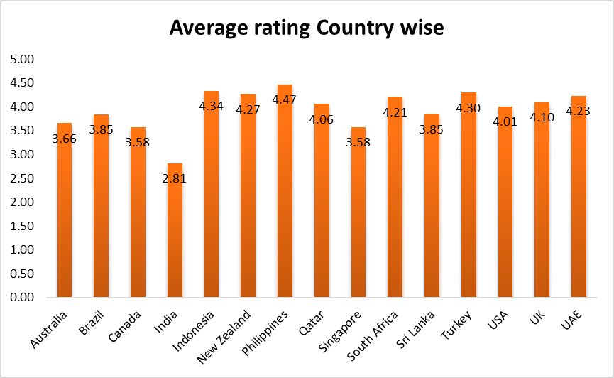
COUNTRIES FOR EXPANSION
Philippines (4.47) – High ratings, low competition.
Indonesia (4.34) – Strong market, quality restaurants.
Turkey (4.3) – Established food scene, moderate competition.
New Zealand (4.27) – Growth potential, good customer satisfaction.
Sri Lanka (3.85) – Lowest competition, scope for improvement.
Average rating Country Wise

Slide 12
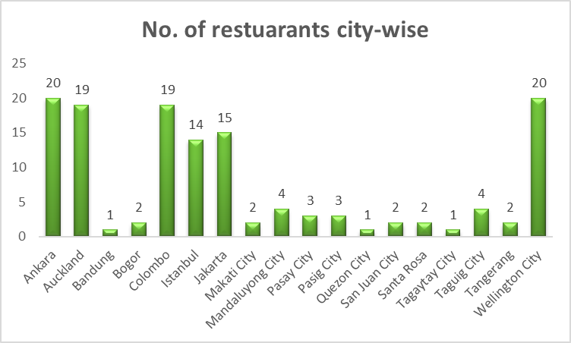
RECOMMENDED CITIES/STATES
Indonesia:Jakarta, Tangerang.
NewZealand:Auckland, Wellington.
Philippines:QuezonCity, Makati City.
Sri Lanka: Colombo.
Turkey: Ankara, Istanbul.
Number of Restaurants City-wise

Slide 13
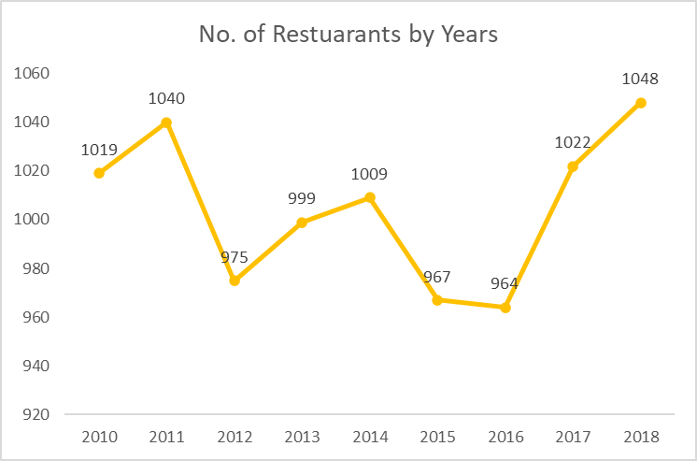
YEARLY RESTAURANT OPENINGS
Peak Years: Highest restaurant count in 2018 (1,048) & 2011 (1,040).
Lowest Count: 2016 had the least listings (964).
Consistent Growth: Fluctuations but overall stable trend.
No. of Restaurants by Years

Slide 14
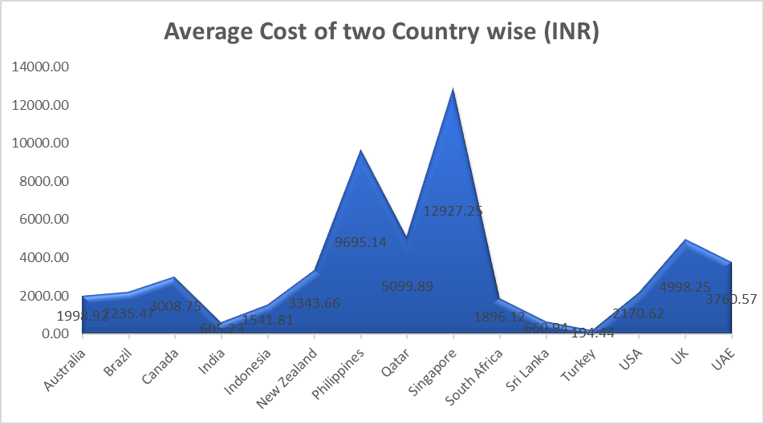
FOOD EXPENDITURE IN TARGET COUNTRIES
Most Affordable: Turkey (194) and Sri Lanka (661)
offer budget-friendly options.
Moderate Costs: Indonesia (1,542) and New Zealand (3,344) provide mid-range spending experiences.
Highest Spending: The Philippines (9,695) is the most expensive destination listed.
Average of Average_Cost_for_two vs. Country Name

Slide 15
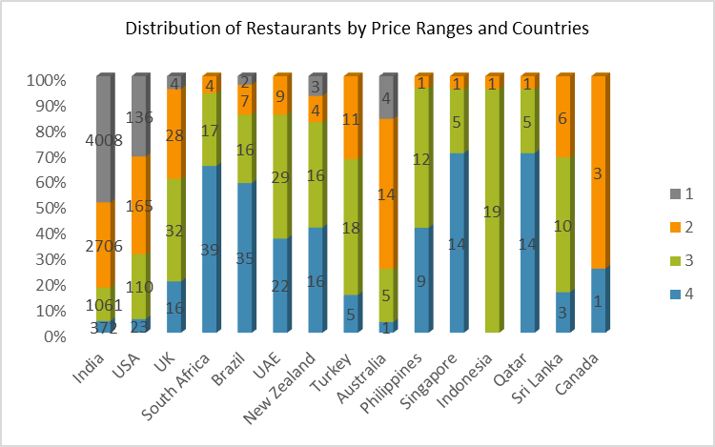
DISTRIBUTION OF RESTAURANTS BY PRICE RANGES AND COUNTRIES
India: Dominated by low-cost dining (4,009 restaurants), focusing on affordability.
United States: Balanced between mid-range (165) and low-cost (136), with potential to expand mid-range options.
High-End Markets: South Africa (39), Brazil (35), Qatar/Singapore (14) show strong potential for premium dining growth.
Distribution of restaurants by price ranges and countries

Slide 16
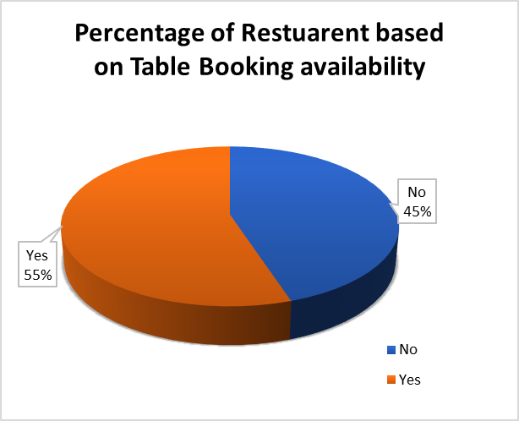
TABLE BOOKING AVAILABILITY
Higher ratings (3.50) for restaurants with table booking.
Customers prefer structured dining experiences.
Adding table booking can improve satisfaction.
Average of Rating vs Has_Table_booking

Slide 17

ONLINE DELIVERY AVAILABILITY
Higher ratings (3.29) for restaurants with online delivery.
Convenience and accessibility boost satisfaction.
Expanding delivery services can enhance ratings.
Average of Rating vs. Has_Online_delivery

Slide 18
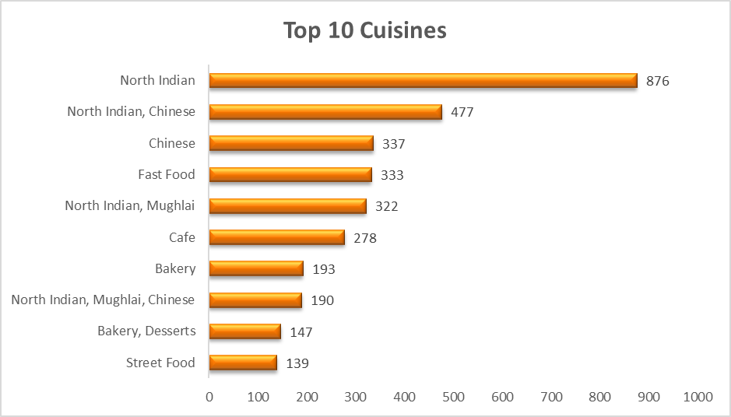
FOCUS CUISINES FOR BETTER FEEDBACK
Cuisine choice directly impacts ratings.
Prioritize top cuisines, refine low-rated ones, expand fusion.
Top Performers: Seafood, Sushi, Japanese, and Desserts have the highest ratings (4.8+).
Underperformers: North Indian, Chinese, and Sri Lankan cuisines receive the lowest ratings (≤2.5).
Average of Rating vs. Cuisines

Slide 19
RECOMMENDATION
Prioritize High-Rated, Low-Cost Cuisines (e.g., World Cuisine, Sushi, Seafood) for better customer appeal.
Expand in High-Growth Markets like India, the USA, and the UK to maximize reach.
Enhance Online Delivery & Table Booking in demand-driven regions for convenience.
Optimize Pricing Strategy since price and ratings show weak correlation (0.238).
Diversify Menu with Popular Cuisines like Desserts and Mexican for increased engagement.
Improve Service Quality to drive better ratings and repeat customers.

Slide 20
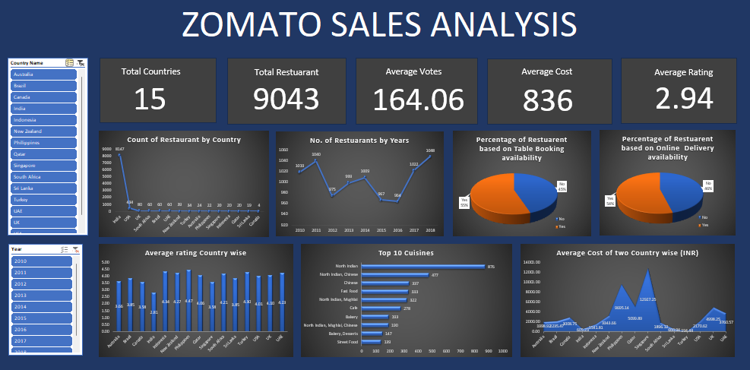

Slide 21
CONCLUSION
Top Cuisines Drive Success: World Cuisine, Sushi, and Seafood consistently receive the highest ratings.
Pricing Has Minimal Impact: Weak correlation (0.238) between price and ratings; quality matters more.
Market Expansion Focus: India, USA, and UK offer the highest restaurant growth opportunities.
Competitor Insights: Identify top competitors and low-rated restaurants for strategic positioning.
Online Delivery & Table Booking: Essential features for attracting more customers.
Optimized Pricing Strategy: High-rated, low-cost cuisines can maximize profitability.

Slide 22


